Slide 1



B.TECH PROJECT-I (CO-401)
IMPROVING THE ACCURACY AND COMPARING MACHINE LEARNING TECHNIQUES IN HEART DISEASE PREDICTION
Presented By -
Aanchal Kumari Shah (2K20/CO/004)
Bibek Khadka (2K20/C0/126)
Rohit Kumar Shah(2K20/CO/374)

Slide 2
CONTENTS
INTRODUCTION
OBJECTIVE
ALGORITHM USED
LITERATURE SURVEY
PROPOSED MODEL
APPLICATIONS
RESULT AND FUTURE WORK

Slide 3
INTRODUCTION
Difficult to identify heart disease because of several contributory risk factors such as diabetes, blood pressure, cholesterol, pulse rate and many other factors.
Automated Prediction about the heart condition of patient so that further treatment can be made more effective.
Diagnosis of Heart Diseases based on signs and symptoms of the patients.
The severity of the disease is classified based on various methods like SVM, LR and ANN.
Heart disease is complex and hence it must be handled carefully.

Slide 4
OBJECTIVES
Objective of this research is to develop a heart prediction system, the system can discover and extract hidden knowledge associated with diseases from heart data set.
Aims to exploit machine learning techniques on medical data set to assist in the prediction of the heart disease.
Reduce the cost of medical tests.
To help avoid human biases.

Slide 5
ALGORITHMS USED
Logistic Regression
Support Vector Machine
Artificial Neural Network

Slide 6
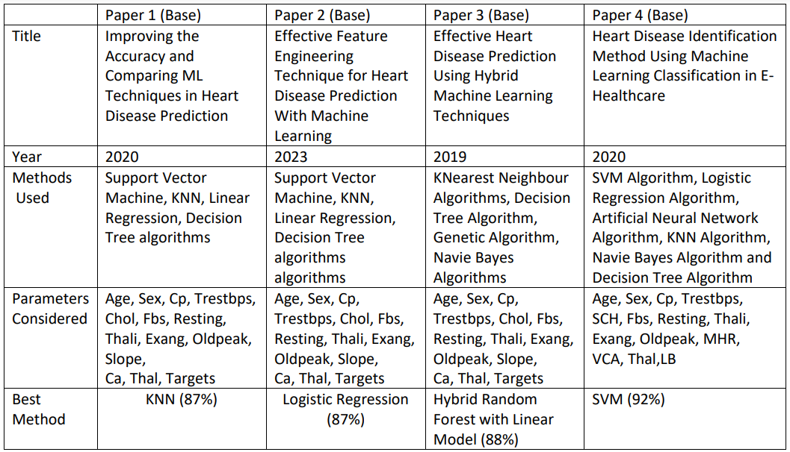
LITERATURE SURVEY

Slide 7
PROPOSED MODEL
HEART DISEASE DATABASE
DATA PREPROCESSING
FEATURE SELECTION
OUTPUTS
LR, SVM, ANN ALGORITHMS

Slide 8
APPLICATIONS
Medical Institutions:-
To teach medical students how the heart attack been measured, or how to identify that the person is suffering from heart disease.
Hospitals:-
To detect that is the person having heart disease or not.

Slide 9
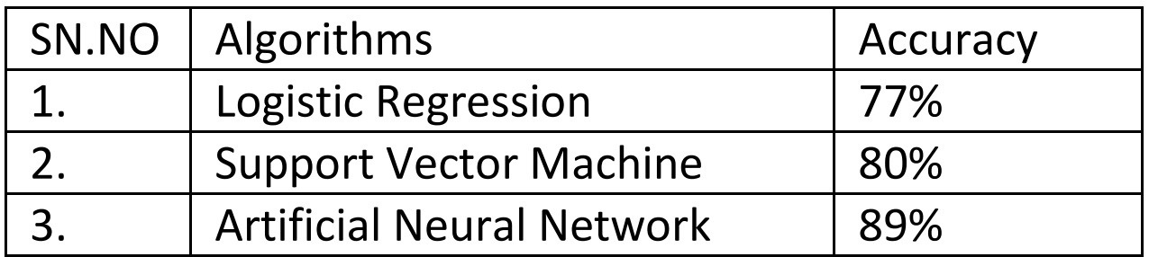
RESULTS AND FUTURE WORK
For future work,
More machine learning method and module will be used and the accuracy will be analysed.
The module will be trained using the text data as well as the image data so called hybrid module.
The module will be compared by the parameters of accuracy, sensitivity and specificity.
The different health parameters related to heart diseases will be studied.

Slide 10

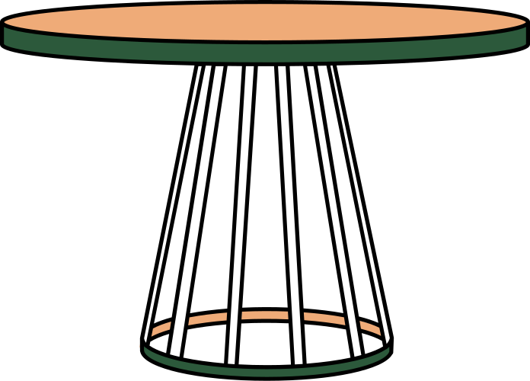
THANK YOU

